Slide 1

Hotel Reservation System
Project
Faculty of Information & Computers
AI Department

Slide 2




Team
Ziad
Elgohary
Omar
Bahnasy
Ebrahim
Elsaeed
Adam Kamal
Supervision
Dr. Osama Ghoneim Eng. Omar Khaled

Slide 3
Introduction
Hotel Management System
This project is a Hotel Booking Management System developed using C++. It is designed to simplify hotel reservation operations by providing an efficient and user-friendly console-based management solution.
The system allows users to manage room reservations, check room availability, search booking records, and cancel reservations easily. It supports different room categories including Standard, Deluxe, and Suite, with automatic validation of booking dates and room availability.
Additionally, the system stores booking information in CSV files, ensuring data persistence and easy record management. The main goal of this project is to demonstrate the application of Object-Oriented Programming (OOP) concepts, file handling, data validation, and efficient booking management in a real-world scenario.

Slide 4
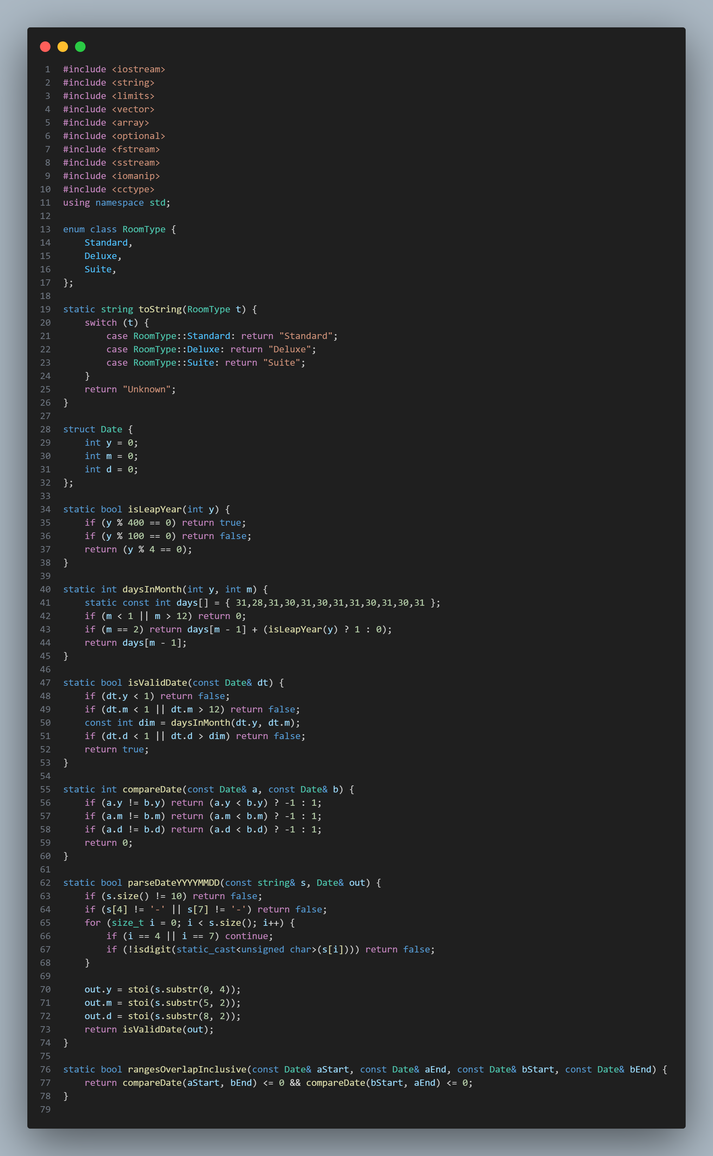
Code Explanation Block1(1-79):
Date Validation and Booking Conflict Detection
This part of the system is responsible for handling and validating booking dates to ensure accurate reservation management.
First, the program checks whether the entered date is valid by verifying the year, month, and day values. It also considers leap years to correctly handle February dates.
The system then compares two dates to determine their chronological order, which helps ensure that the check-out date comes after the check-in date.
Additionally, the program detects date range overlaps between bookings. This prevents multiple guests from booking the same room during overlapping periods, ensuring that room reservations remain accurate and conflict-free.
Main Functions:
Leap Year Validation – Checks if a year has 365 or 366 days.
Date Validation – Ensures the entered date is correct.
Date Comparison – Compares two dates chronologically.
Overlap Detection – Prevents booking conflicts for the same room.

Slide 5
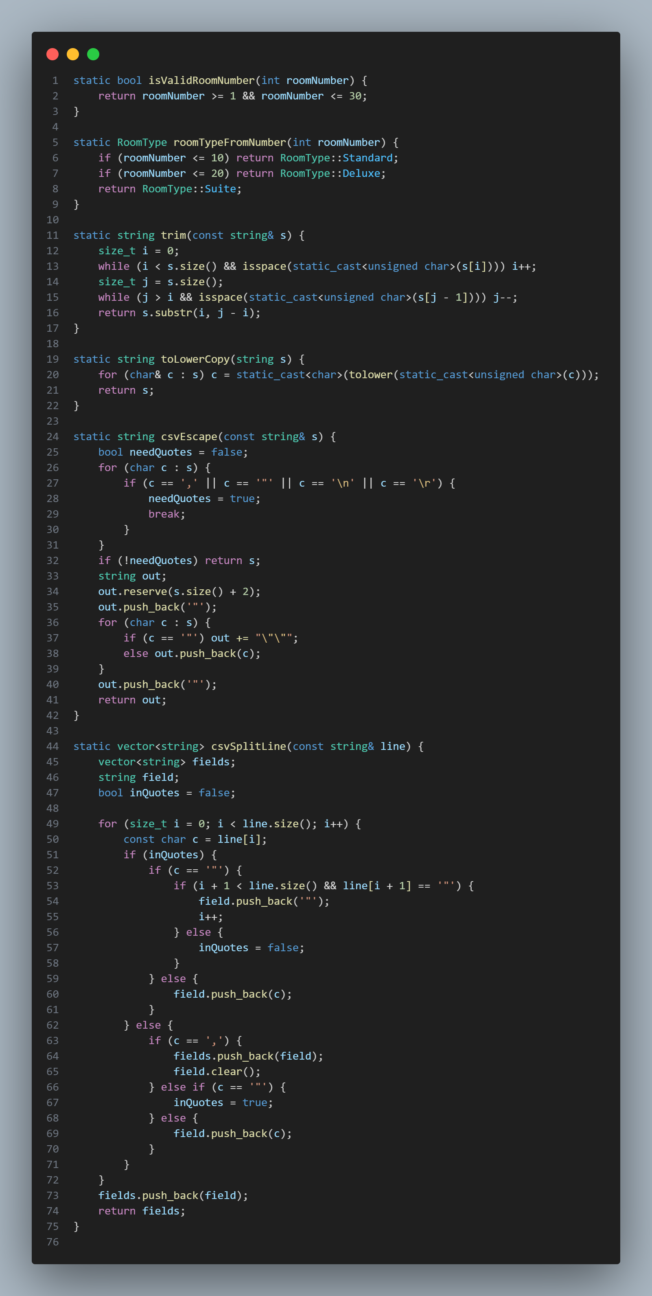
Code Explanation Block1(79-155):
Room Management and Data Processing
This part of the system handles room classification, input formatting, and data storage operations. It ensures that room information and customer data are processed accurately and efficiently.
The system first validates room numbers to make sure they fall within the hotel’s available room range (1 to 30). After validation, each room is automatically assigned a category based on its number:
In addition, the program processes text input by removing unnecessary spaces and converting text to lowercase when needed. This improves search accuracy and input consistency.
For data storage, the system uses CSV file handling. Special characters are properly formatted before saving data, and stored records can be accurately read and separated into individual fields when loaded back into the system.
Main Functions:
Room Validation – Checks if the room number is valid.
Room Classification – Assigns the correct room type.
Text Processing – Cleans and standardizes user input.
CSV Formatting – Saves and retrieves booking data safely.

Slide 6
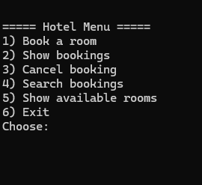
Console Output Explanation:
System Execution and User Interface
This part represents the main execution flow of the hotel booking system. The run() function is responsible for displaying the main menu and controlling user interaction with the program.
When the system starts, a menu appears on the screen showing all available operations. The user can select different options to manage hotel bookings easily.
The menu provides the following features:
Book a Room – Create a new reservation for a guest.
Show Bookings – Display all current booking records.
Cancel Booking – Remove an existing reservation using the booking ID.
Search Bookings – Search for reservations by guest name or room number.
Show Available Rooms – Display all available rooms for a selected date range.
Exit – Close the system safely.
The run() function continuously loops until the user chooses the exit option, ensuring smooth navigation and continuous system operation.

Slide 7
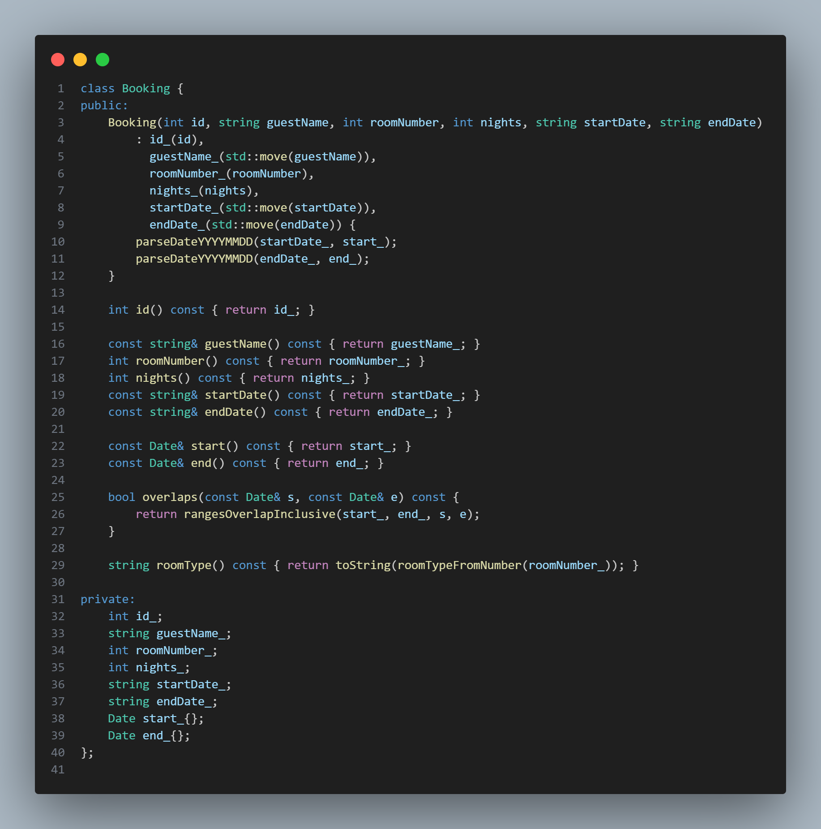
Code Explanation Block2(156-196):
Booking Class Implementation
This part of the system represents the Booking class, which is responsible for storing and managing reservation information for each guest. It acts as the core data structure of the hotel booking system.
Each booking object contains essential reservation details, including:
Booking ID – A unique identifier for each reservation.
Guest Name – The name of the customer.
Room Number – The assigned room for the booking.
Number of Nights – The duration of the stay.
Check-in and Check-out Dates – Reservation period.
When a booking is created, the system automatically converts the entered date strings into date objects for easier validation and comparison.
The class also provides additional functionalities such as:
Accessing booking details through getter functions.
Checking booking overlap to detect reservation conflicts.
Identifying room type automatically based on the room number.
This class helps organize booking information efficiently while supporting accurate reservation management.

Slide 8
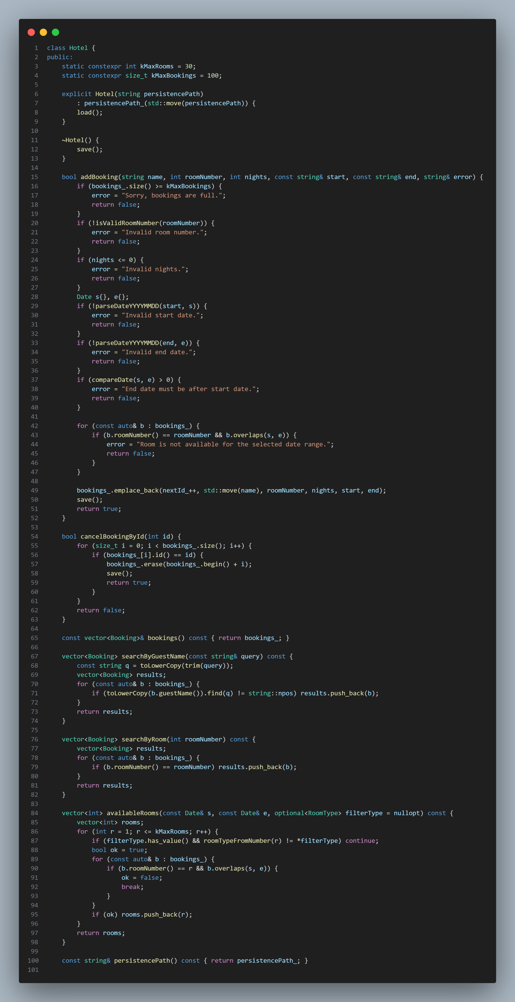
Code Explanation Block2(197-297):
Hotel Class Implementation
This part of the system represents the Hotel class, which is responsible for managing all booking operations and controlling the hotel reservation process. It acts as the main controller of the application.
The class manages a maximum of 30 rooms and supports up to 100 bookings. It also handles data loading and saving automatically to ensure booking information is preserved.
The main responsibilities of this class include:
Key Functions:
Add Booking Creates a new reservation after validating room number, number of nights, booking dates, and room availability. It also prevents duplicate bookings during overlapping dates.
Cancel Booking Removes an existing reservation using the unique booking ID.
Search Bookings Allows searching reservations by:
Guest name
Room number
Check Available Rooms Displays all available rooms for a selected date range, with the option to filter by room type.
Data Persistence Automatically saves booking records and reloads them when the system starts.
This class serves as the core business logic of the project, ensuring that all hotel operations are handled efficiently and accurately.

Slide 9
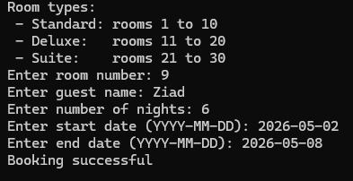
Console Output Explanation:
Booking Process Execution
This output demonstrates the practical execution of the room booking process within the hotel management system.
First, the system displays all available room categories and their corresponding room numbers, helping the user choose the appropriate room type.
The user then enters the required booking information, including:
Room number
Guest name
Number of nights
Check-in date
Check-out date
After receiving the input, the system validates all entered data, including room availability and date correctness. If all conditions are satisfied, the booking is successfully created and stored in the system.
The final message "Booking successful" confirms that the reservation has been completed without any conflicts or errors.

Slide 10
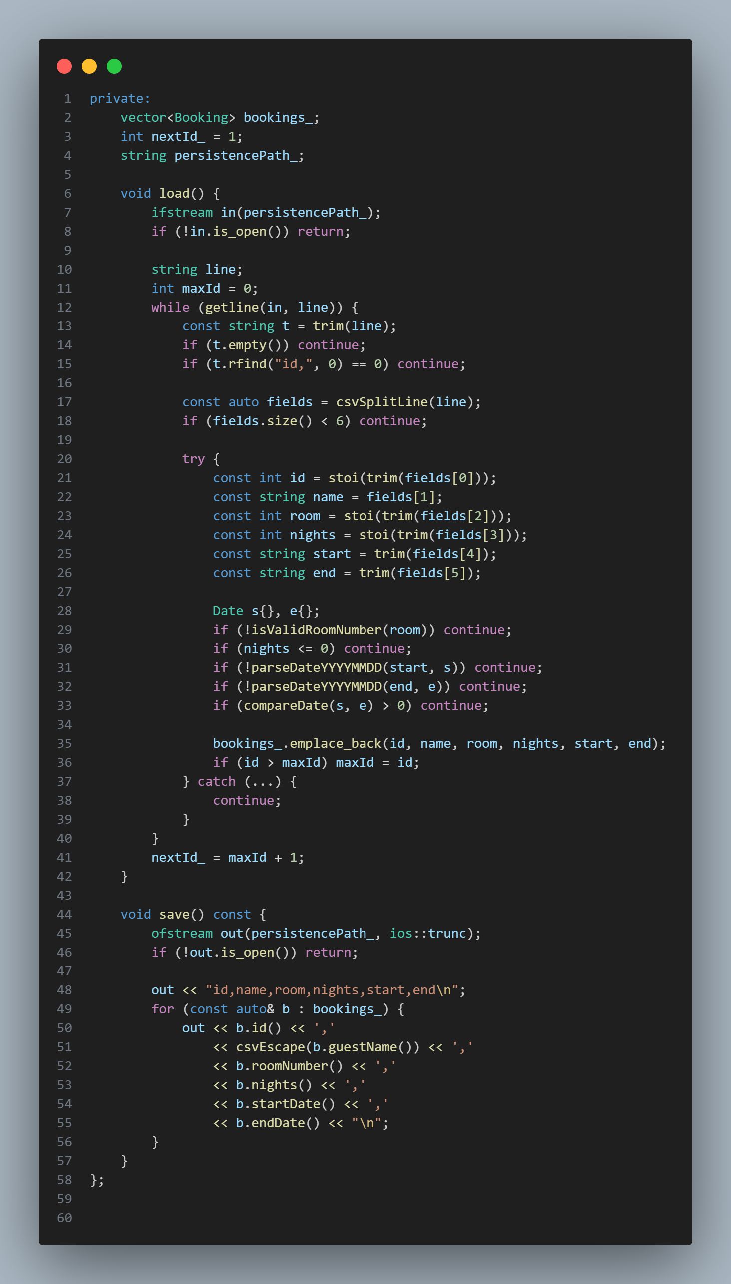
Code Explanation Block3(298-356):
Data Storage and File Management
This part of the system is responsible for saving and loading booking data using CSV file storage. It ensures that all reservation records are preserved even after closing the program.
Main Functions:
Load Data When the system starts, the load() function reads booking records from the CSV file. It validates each record by checking:
Room number validity
Number of nights
Date format and date order
Only valid booking records are loaded into the system.
Save Data The save() function stores all current bookings into the CSV file. Each reservation is saved with important details such as:
Booking ID
Guest name
Room number
Number of nights
Check-in date
Check-out date
Automatic ID Management The system tracks the highest booking ID and automatically generates the next available ID for new reservations.
This mechanism guarantees data persistence, accuracy, and reliable record management throughout system operation.

Slide 11
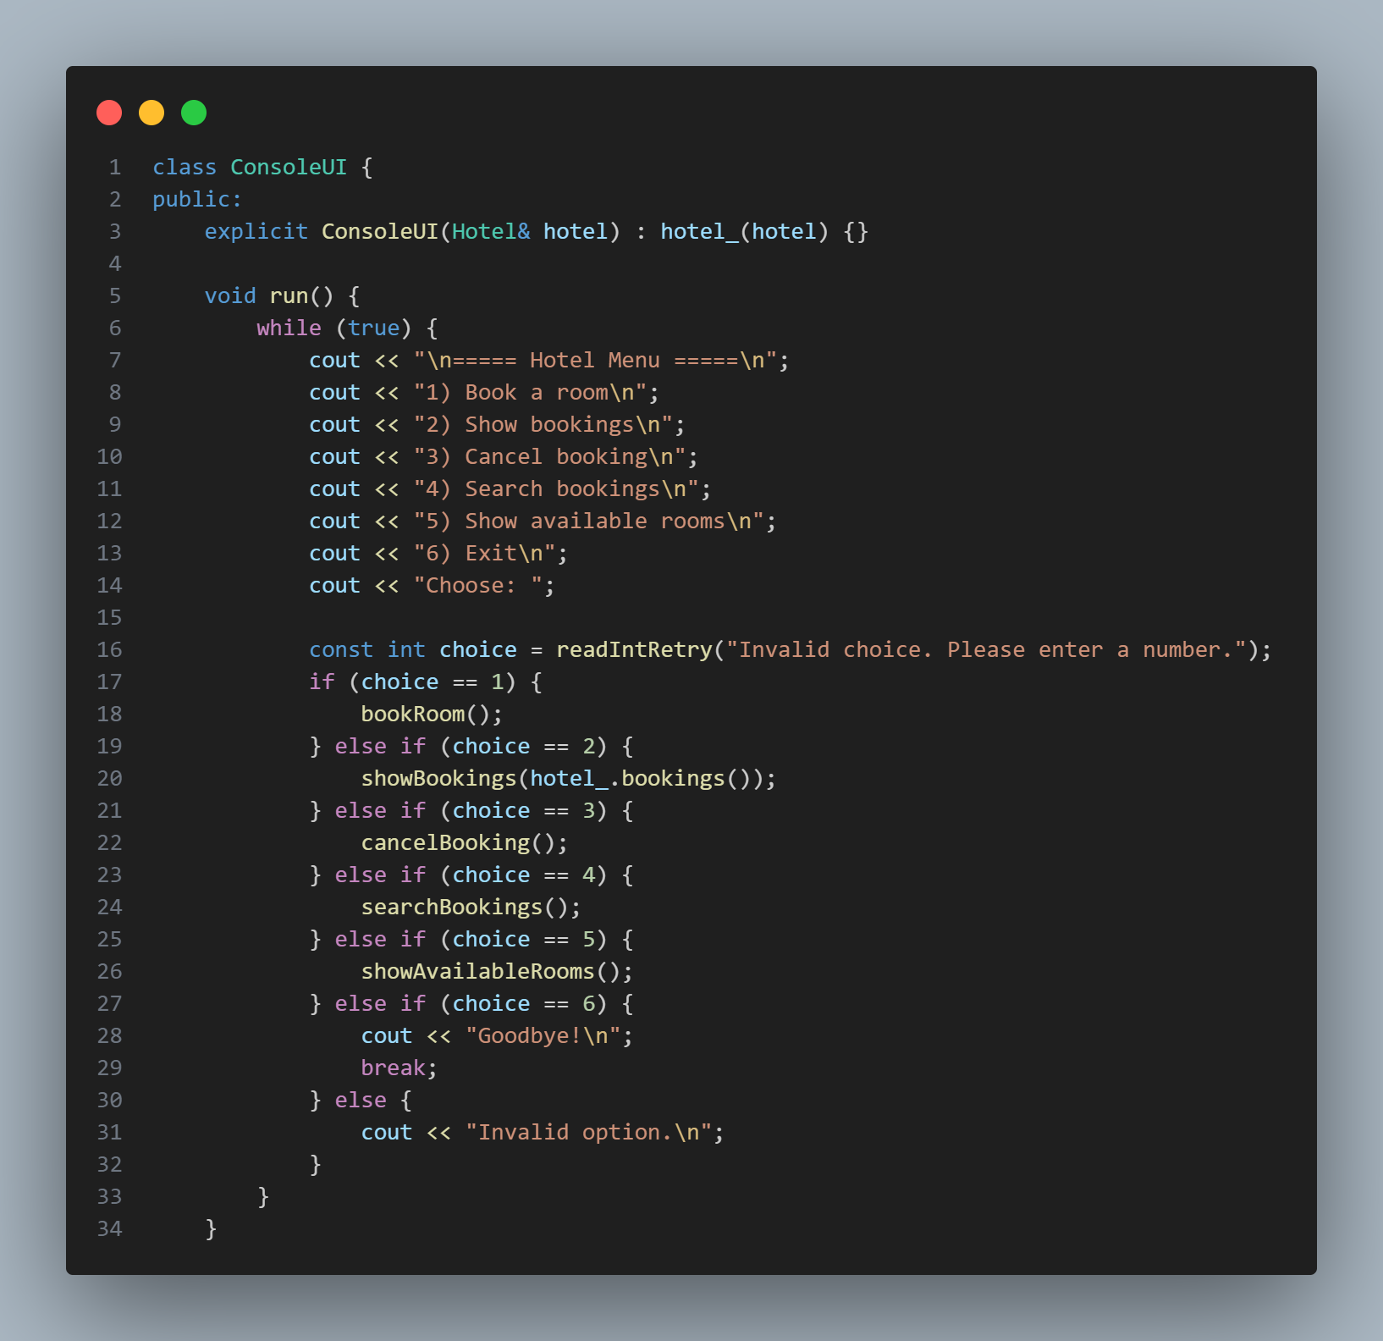
Code Explanation Block3(357-390):
ConsoleUI Class Overview
The ConsoleUI class is responsible for managing all user interactions in the hotel system through a simple console menu.
It provides a continuous menu-driven interface that allows users to perform different actions such as booking rooms, viewing bookings, canceling reservations, searching, and checking available rooms.
The system keeps running in a loop until the user chooses to exit, ensuring smooth and continuous interaction.
User input is validated to prevent errors, and each menu option is linked to a specific function in the hotel system.
Overall, this class acts as the main bridge between the user and the hotel management logic.

Slide 12
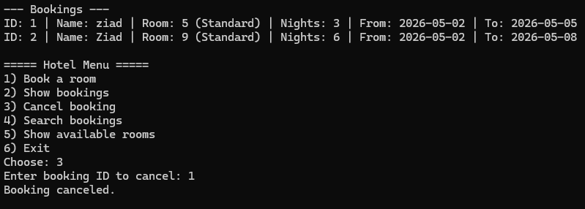
Console Output Explanation:
Bookings Management & Cancellation (Runtime Output)
This screen shows the system displaying all current bookings with full details such as customer name, room number, booking duration, and dates.
It also demonstrates the cancellation feature, where the user selects a booking by its ID and successfully removes it from the system.
This reflects the system’s ability to:
Display real-time booking data
Manage reservations dynamically
Allow safe cancellation with user confirmation
Overall, it proves that the system handles both data retrieval and modification efficiently.

Slide 13
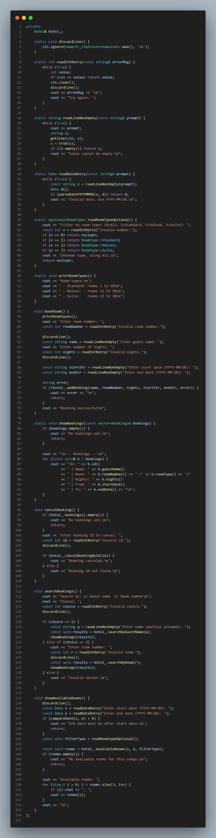
Code Explanation Block3(392-548):
Concise explanation for presentation slides:
It contains a reference to the Hotel object (hotel_), which is used to perform all main operations like booking, canceling, and searching.
Input helper functions:
discardLine() → Clears input buffer to avoid input errors.
readIntRetry() → Reads integers safely with validation and retry on failure.
readLineNonEmpty() → Ensures user enters non-empty text input.
readDateRetry() → Reads and validates date input in YYYY-MM-DD format.
Room type handling:
readRoomTypeOptional() → Allows filtering rooms by type (Standard, Deluxe, Suite, or All).

Slide 14
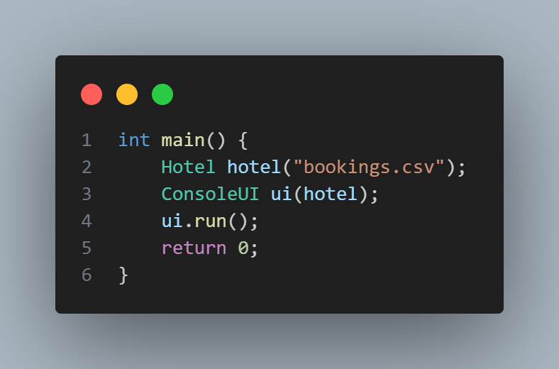
Code Explanation Block3(549-554):
Main Function Explanation (for presentation slide)
This is the entry point of the program where execution starts.
A Hotel object is created:
Hotel hotel("bookings.csv");
It loads or manages booking data stored in the file bookings.csv.
A ConsoleUI object is created:
ConsoleUI ui(hotel);
It connects the user interface with the hotel system so the UI can perform operations on hotel data.
The program starts running:
ui.run();
This launches the main menu loop where the user can interact with the system (book, cancel, search, etc.).
Finally:
return 0; indicates the program ended successfully.

Slide 15
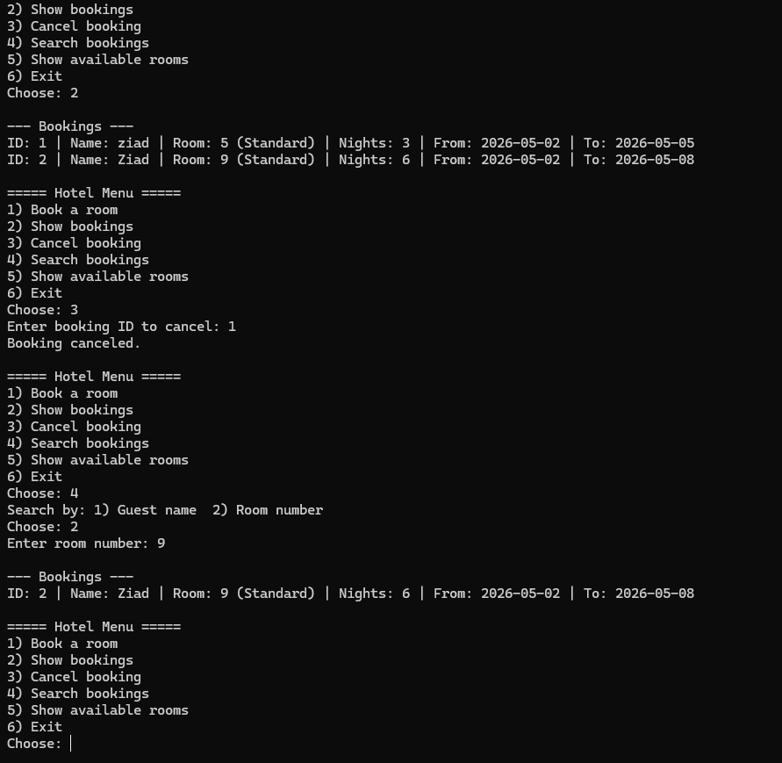
Console Output Explanation:
Runtime Demonstration of the Hotel Booking System Shows booking, search, and management features in console mode
System Running Result Main menu and booking operations in action
Program Execution (Run Output) Hotel Booking System Console Interface

Slide 16

Conclusion
This Hotel Reservation System successfully demonstrates a complete and efficient solution for managing room bookings, cancellations, and availability tracking. It ensures data accuracy through strong validation of dates, room numbers, and booking constraints.
The system supports multiple room types, prevents overlapping reservations, and maintains persistent storage using file handling to preserve data between sessions. It also provides user-friendly search and filtering options to improve usability.
Overall, the project showcases the practical application of object-oriented programming, data structures, and file management in C++, delivering a reliable and scalable solution for real-world hotel management needs.
Special Thanks: I would like to express my sincere gratitude to Dr. Osama Ghoneim and for Eng. Omar Khaled their continuous support and guidance throughout this course.

Slide 17


Thank you
For your time

